Slide 1

Ayurveda GPT
Aaryan Patel
Gourav Amolekar
Nikhil Sen

Slide 2
We know, that You know about Ayurveda!!!
But this is about Ayurveda GPT
Ayurveda is an alternative medicine system that originated in the Indian subcontinent. It's based on the idea that disease is caused by an imbalance or stress in a person's consciousness.

Slide 3
The Ayurveda GPT
Ayurveda GPT is an AI chatbot like ChatGPT that trained on Ayurved data or knowledge.
In simple words, It is like a virtual assistant that can help you use and learn about Ayurveda in daily life to improve your health and well-being.
That’s it!

Slide 4
You know about Ayurveda.
But you don’t use!
That’s the Problem 😒
Problem Domain

Slide 5
So, What is the Solution? 🤔

Slide 6
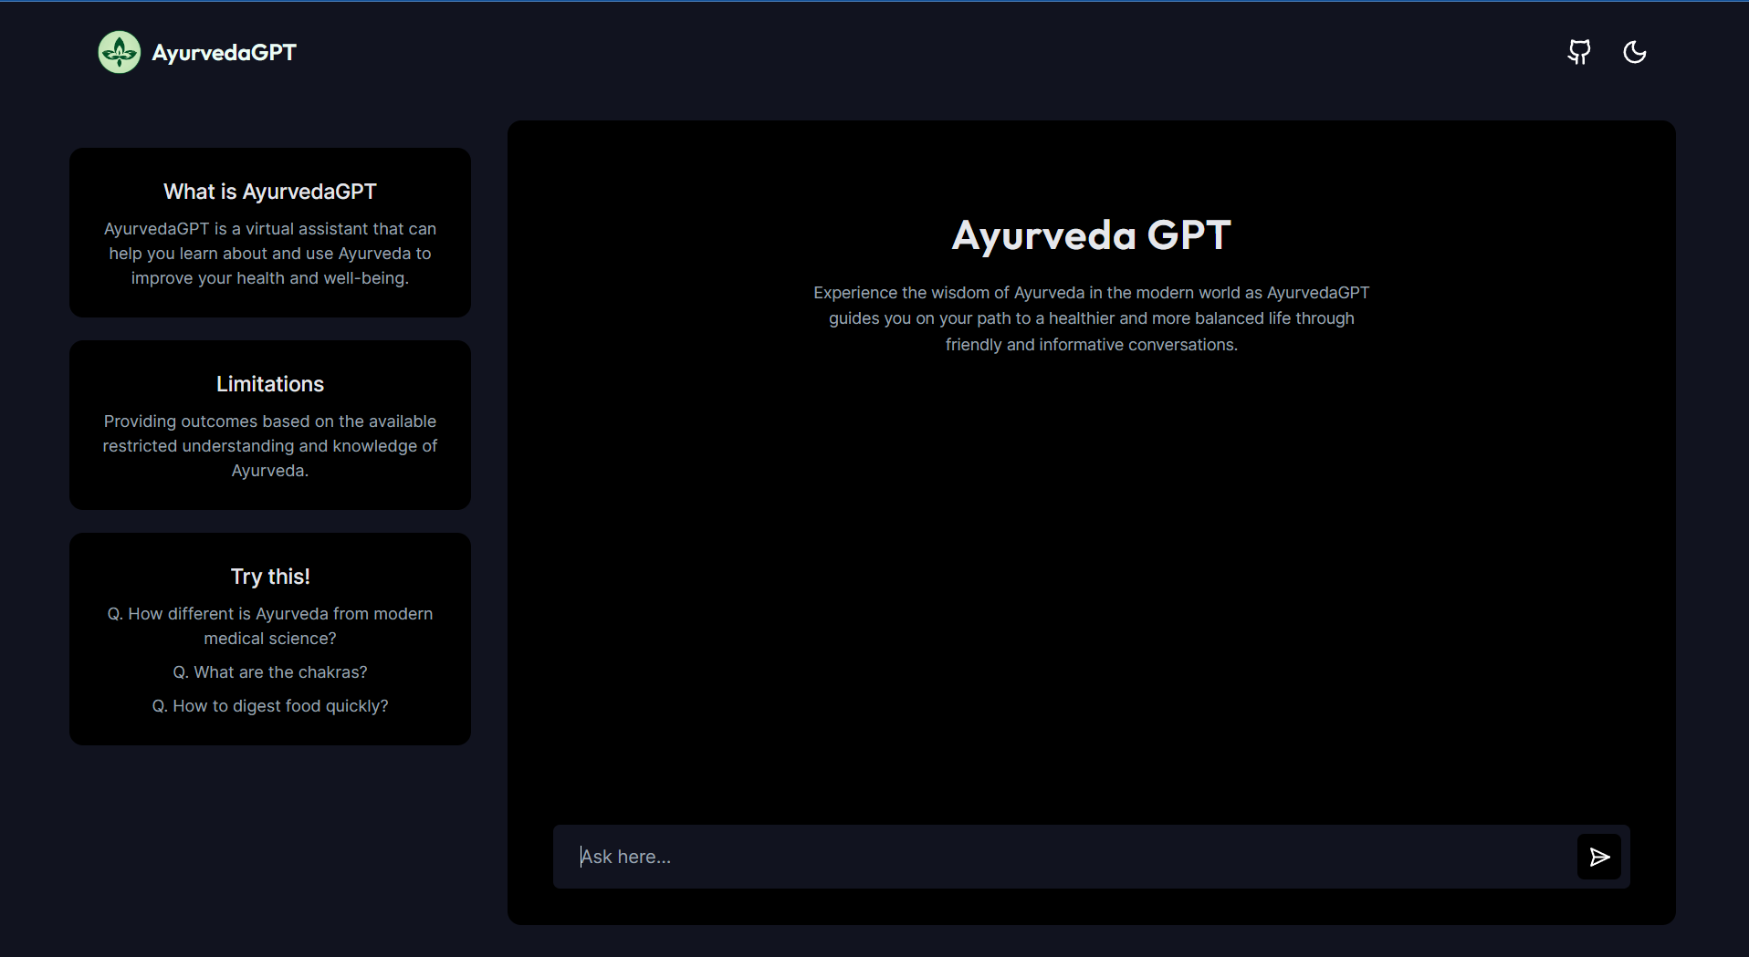
Go to -> ayurvedagpt.vercel.app
Ask here
Press Enter

Slide 7
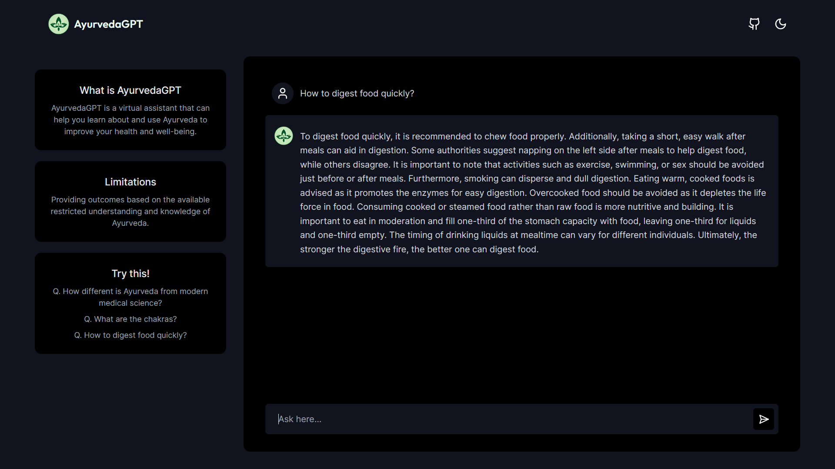
That’s it!

Slide 8




Technologies are being used!!!

Slide 9
To build it, we needed for
A web Framework
Data for Ayurveda
A LLM Framework
Storage to store data
An AI library to build chatbot
An Hosting platform
RGA

Slide 10
Softwares
NextJs - web Framework
A pdf book - Ayurveda data
Langchain - A LLM Framework
Supabase - Storage to store data
Vercel AI SDK - AI library
Vercel - Hosting platform
SRS

Slide 11
Use Case Diagram
Write a query
And gain knowledge
Get the result

Slide 12
ER Diagram
Database
Website
User
Langchain (LLM)
Output
Input
OpenAI

Slide 13
Data flow Diagram
Database
Website
Input + previous chat
Langchain (LLM)
Output
Output
OpenAI

Slide 14
Class Diagram
Chat Message
Vector Embedding
id | role | content
1 | user | Hi
2 | bot | Hey, How can I help you?
3 | user | Tell me about…
[Hello, World]-> [12.4.11.04, 43.5.2.12]

Slide 15
Limitations & Future Enhancement
It is basically trained on very limited data,
What if we provide all medical data not just about ayurveda!?

Slide 16
Conclusion
Ayurveda GPT is an impressive chatbot that shows the potential of large language models to be used for educational and informative purposes.
It is a well-designed and informative chatbot that has the potential to be a valuable tool for anyone interested in learning more about Ayurveda.

Slide 17
Reference
To Youtubers 🫡
&
Guided By Prof. Kapil Shah Sir

Slide 18
Thank you for your time and attention
🙂

